Slide 1
Model Checking

Slide 2
Safety and Liveness
Safety properties
  Invariants, deadlocks, reachability, etc.
  Can be checked on finite traces
  “something bad never happens”
Liveness Properties
  Fairness, response, etc.
  Infinite traces
  “something good will eventually happen”

Slide 3
Model Checking Process
[ Adapted from www.lix.polytechnique.fr/comete/seminar/1-ModelChecking.ppt]
Answer:
Yes, if model satisfies
specification
Counterexample, otherwise
Model
(System Requirements)
Model
Checker
Specification
(System Property)
M╞ φ
For increasing our confidence in the correctness of the model:
Verification: The model satisfies important system properties
Debugging: Study counter-examples, pinpoint the source of the error, correct the model, and try again

Slide 4
Mutual Exclusion Example
Model
(System Requirements)
The Model (Willem Visser, http://ase.arc.nasa.gov/visser/ASE2002TutSoftwareMC-fonts.ppt)
Two process mutual exclusion with shared semaphore
Each process has three states
  Non-critical (N)
  Trying (T)
  Critical (C)
Semaphore can be available (S₀) or taken (S₁)
Initially both processes are in the Non-critical state and
the semaphore is available --- N₁ N₂ S₀
N₁ → T₁
T₁ ∧ S₀ → C₁ ∧ S₁
C₁ → N₁ ∧ S₀
||
N₂ → T₂
T₂ ∧ S₀ → C₂ ∧ S₁
C₂ → N₂ ∧ S₀

Slide 5
Mutual Exclusion Example
Model
(System Requirements)
The Model (Willem Visser, http://ase.arc.nasa.gov/visser/ASE2002TutSoftwareMC-fonts.ppt)
Initially both processes are in the Non-critical state and the semaphore is available --- N₁ N₂ S₀
N₁ → T₁
T₁ ∧ S₀ → C₁ ∧ S₁
C₁ → N₁ ∧ S₀
||
N₂ → T₂
T₂ ∧ S₀ → C₂ ∧ S₁
C₂ → N₂ ∧ S₀
N₁N₂S₀
T₁N₂S₀
N₁T₂S₀
C₁N₂S₁
T₁T₂S₀
N₁C₂S₁
C₁T₂S₁
T₁C₂S₁

Slide 6
Mutual Exclusion Example
Specification
(System Property)
Specification – Desirable Property
No matter where you are there is
always a way to get to the initial state
K ╞ AG EF (N₁ ∧ N₂ ∧ S₀)
Kripke structure
CTL (Computation Tree Logic)
M╞ φ

Slide 7
Mutual Exclusion Example
Model
(System Requirements)
N₁N₂S₀
T₁N₂S₀
N₁T₂S₀
C₁N₂S₁
T₁T₂S₀
N₁C₂S₁
C₁T₂S₁
T₁C₂S₁
Model
Checker
Answer: Yes
Specification
(System Property)
M╞ φ
K ╞ AG EF (N₁ ∧ N₂ ∧ S₀)

Slide 8
Mutual Exclusion Example
Answer: Yes
A Proof:
For All possible behaviors
N₁N₂S₀
T₁N₂S₀
N₁T₂S₀
C₁N₂S₁
T₁T₂S₀
N₁C₂S₁
C₁T₂S₁
T₁C₂S₁

Slide 9
Mutual Exclusion Example
N₁N₂S₀
T₁N₂S₀
N₁T₂S₀
C₁N₂S₁
T₁T₂S₀
N₁C₂S₁
C₁T₂S₁
T₁C₂S₁
N₁N₂S₀
T₁N₂S₀
N₁T₂S₀
C₁N₂S₁
T₁T₂S₀
N₁C₂S₁
C₁T₂S₁
T₁C₂S₁

Slide 10
Mutual Exclusion Example
N₁N₂S₀
T₁N₂S₀
N₁T₂S₀
C₁N₂S₁
T₁T₂S₀
N₁C₂S₁
C₁T₂S₁
T₁C₂S₁
N₁N₂S₀
T₁N₂S₀
N₁T₂S₀
C₁N₂S₁
T₁T₂S₀
N₁C₂S₁
C₁T₂S₁
T₁C₂S₁

Slide 11
Mutual Exclusion Example
Specification – Desirable Property
No matter where you are there is
no way to get to the initial state
⌐
K ╞ AG EF (N₁ ∧ N₂ ∧ S₀)

Slide 12
Mutual Exclusion Example
Answer: No
Counterexample
N₁N₂S₀
T₁N₂S₀
N₁T₂S₀
C₁N₂S₁
T₁T₂S₀
N₁C₂S₁
C₁T₂S₁
T₁C₂S₁
N₁N₂S₀
T₁N₂S₀
N₁T₂S₀
C₁N₂S₁
T₁T₂S₀
N₁C₂S₁
C₁T₂S₁
T₁C₂S₁

Slide 13
Defining Models
Model
(System Requirements)
Kripke Structure
K = < S ,P, R > (M = < S ,P, R, L (, {s₀})>) (s₀∈S - initial state)
S: the set of possible global states
P: a non-empty set of atomic propositions {p₁, . . ., p_{k}} which express atomic
properties of the global states, e.g., being an initial state, being an accepting state,
or that a particular variable has a special value.
R⊆ S × S: a transition relation s.t. R(s,s') if s to s' is a possible atomic transition
L: S → 2^{P}: a labeling function which defines which propositions hold in which states.
State explosion problem: The size of S is often exponential in |requirements/design|.
Model checking problem: A model checker checks whether a system, interpreted
as an automaton, is a (Kripke) model of a property expressed as a temporal logic formula.
K |= φ

Slide 14
Defining Models
For a complex real-life control systems
FSM with a way to
modularize the requirements to view them at different levels of detail
combine requirements (or design) of components
- state variables and facilities in guards on transitions.
Extended Finite State Machine (EFSM)

Slide 15
Defining Specifications
Specification
(System Property)
Temporal Logic
  Express properties of event orderings in time
  e.g. “Always” when a packet is sent it will “Eventually” be received
Linear Time
  Every moment has a unique successor
  Infinite sequences (words)
  Linear Time Temporal Logic (LTL)
Branching Time
  Every moment has several successors
  Infinite tree
  Computation Tree Logic (CTL)

Slide 16
Linear Temporal Logic (LTL)
http://en.wikipedia.org/wiki/Linear_temporal_logic
LTL Syntax
  a set of proposition variables p1,p2,...,
  the usual logic connectives and
  the following temporal modal operators:
    N/X for next;
    G/ □ for always (globally);
    F/ ◊ for eventually (in the future);
    U for until;
    R for release.
o Next cycle
(-) previous cycle
One can reduce to two of those operators since the following is always satisfied:
  F φ = true U φ
  G φ = false R φ = F φ
  ψ R φ = ( ψ U φ)

Slide 17






Linear Temporal Logic (LTL)
LTL (Informal) Semantics
Textual | Symbolic | Explanation | Diagram
Unary operators:
N φ |  | Next: φ has to hold at the next state. (X is used synonymously.)
G φ |  | Globally: φ has to hold on the entire subsequent path.
F φ |  | Finally: φ eventually has to hold (somewhere on the subsequent path).
Binary operators:
ψ U φ |  | Until: φ holds at the current or a future position, and ψ has to hold until that position. At that position ψ does not have to hold any more.
ψ R φ |  | Release: ψ releases φ if φ is true until the first position in which ψ is true (or forever if such a position does not exist).

Slide 18
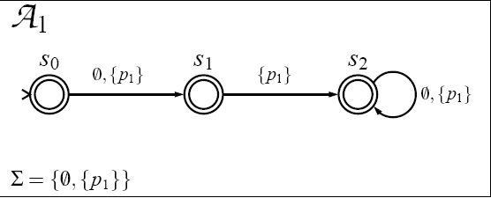
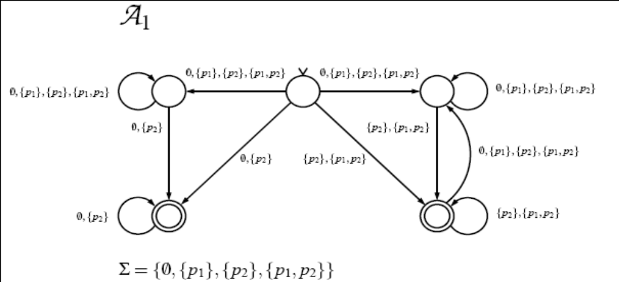
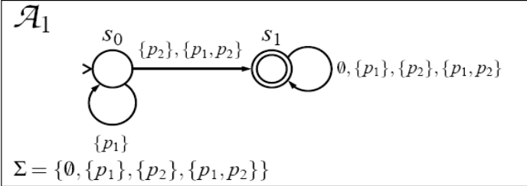
Linear Temporal Logic (LTL)
Model
http://www.cs.utah.edu/classes/cs6964/lectures/15:10_18/timo-latvala/timo7.pdf
A (nondeterministic) Büchi automaton as a model of a LTL formula
A (nondeterministic) Büchi automaton Α is a tuple (∑,S,S₀,∆,F), where
  • ∑ is a finite set of alphabets,
  • S is a finite set of states,
  • S₀ ⊆ S is a set of initial states,
  • ∆ ⊆ S×∑×S is the transition relation, and
  • F ⊆ S is the set of accepting states.
X p₁ as Büchi Automaton
(◊p₁)) → (◊p₂) as Büchi Automaton
p₁U p₂ as Büchi Automaton

Slide 19
Linear Temporal Logic (LTL)
LTL Semantics
  M, π |= p if p∈L(π₀)
  M, π |= ¬p if M, π |≠ p
  M, π |= p∧q if M, π |= p and M, π |= q
  M, π |= p∨q if M, π |= p or M, π |= q
  M, π |= Op if M, π¹ |= p
  M, π |= ⟨⟩p if ∃i≥0: M, π^{i} |= p
  M, π |= p if ∀i≥0: M, π^{i} |= p
  M, π |= pUq if ∃i≥0: M, π^{i} |= q and ∀j<i: M, π^{j} |= p
  M, π |= pRq if ∀i≥0: M, π^{i} |= q or ∃i≥0: M, π^{i} |= p and ∀j≤i: M, π^{j} |= q
M |= p if ∀π∈π(M): M, π|= p
The satisfiability problem of LTL is PSPACE-complete.

Slide 20
Linear Temporal Logic (LTL)
safety properties: something bad never happens (G φ)
Every counterexample has a finite prefix such that,
however it is extended to an infinite path, it is still a counterexample.
liveness properties: something good keeps happening (GFψ or G Fψ)).
Every finite prefix of a counterexample can be extended to an infinite path
that satisfies the formula.
Safety Examples
  []({readySignal == 1} → (){ackSignal == 0})
- This assertion states "Always, readySignal equals one implies ackSignal equals zero on the next cycle".
  It makes use of the Always operator (the box) and the Next Cycle operator (the empty parentheses pair).
  []({readySignal == 1} → (-){ackSignal == 0})
- This assertion states “Always, readySignal equals one impliesackSignal equals zero on the previous cycle“
  Makes use of the previous cycle operator (-)
Liveness Example
  ◊({out1==1} && ()()[]{out2 < 2} && (-){out3==0})
  This assertion states "Eventually, out1 will equal one, and then two cycles later and always after that, out2 is less than two and on the previous cycle out3 equals zero.
  This example uses the Eventually operator (the diamond <>), the always operator (the box []), and the Next and Previous Cycle operators (the empty parentheses pair () and the parenthesized minus sign (-), respectively.

Slide 21
LTL - SPIN Model Checker
Kripke structures are described as “programs” in the PROMELA language
  Kripke structure is generated on-the-fly during model checking
Automata based model checker
  Translates LTL formula to Büchi automaton
So far the most popular model checker
  10th SPIN Workshop held with ICSE – May 2003
Relevant theoretical papers can be found here
  http://netlib.bell-labs.com/netlib/spin/whatispin.html
Ideal for software model checking due to expressiveness of the PROMELA language
  Close to a real programming language
Gerard Holzmann won the ACM software award for SPIN
Cf: SCR & the 4-variable model
Requirements should contain nothing but information about the environment.

Slide 22
Branching Temporal Logic (BTL)
Computation Tree Logic (CTL) Syntax
http://www.cs.ucl.ac.uk/staff/J.Bowen/GS03/w3_l1_ctl_notes.pdf
A CTL wff ϕ is (p is an atomic property/proposition):
ϕ ::= ⊤ | ⊥ | p | ￢ φ | φ ∧ ψ | φ ∨ ψ | φ → ψ | AX φ | EX φ |
AF φ | EF φ | AG φ | EG φ | A[φU ψ] | E[φU ψ]
R (‘‘Release’’)
EX φ true in current state if formula φ is true in at least one of the next states
E φUψ true in current state if formula φ is true until ψ becomes true in some path beginning
in current state that satisfies the formula φ
EF φ true in current state if there exists some state in some path beginning in current state
that satisfies the formula φ
EG φ true in current state if every state in some path beginning in current state that
satisfies the formula φ
AX φ true in current state if formula φ is true in every one of the next states
A φUψ true in current state if formula φ is true until ψ becomes true in every path beginning
in current state that satisfies the formula φ
AF φ true in current state if there exists some state in every path beginning in current state
that satisfies the formula φ
AG φ true in current state if every state in every path beginning in current state satisfies the
formula φ

Slide 23
Branching Temporal Logic (BTL)
Computation Tree Logic (CTL) Semantics
Let M = (S,R, L) be a transition system (or a Kripke structure, also called a model for CTL).
Let ϕ be a CTL formula and s ∈ S.
Then M, s |= ϕ is defined inductively on the structure of ϕ, as follows:
M,s |= ⊤
M,s |≠ ⊥
M,s |= p iff p ∈ L(s)
M,s |= ￢ϕ iff M,s |≠ ϕ
M,s |= ϕ ∧ ψ iff M,s |= ϕ and M,s |= ψ
M,s |= ϕ ∨ ψ iff M,s |= ϕ or M,s |= ψ

Slide 24
Branching Temporal Logic (BTL)
Computation Tree Logic (CTL) Semantics
M,s |= AXϕ iff ∀s’ s.t. sRs’, M,s’ |= ϕ
M,s |= EXϕ iff ∃s’ s.t. sRs’ and M,s’ |= ϕ
M,s |= AGϕ iff for all paths (s, s₂, s₃, s₄, . . .) s.t. s_{i}Rs_{i+1}
and for all i, it is the case that M,s_{i} |= ϕ
M,s |= EGϕ iff there is a path (s, s₂, s₃, s₄, . . .) s.t. s_{i}Rs_{i+1}
and for all i it is the case that M,s_{i} |= ϕ
M,s |= AFϕ iff for all paths (s, s₂, s₃, s₄, . . .) s.t. s_{i}Rs_{i+1},
there is a state s_{i} s.t. M,s_{i} |= ϕ
M,s |= EFϕ iff there is a path (s, s₂, s₃, s₄, . . .) s.t. s_{i}Rs_{i+1},
and there is a state s_{i} s.t. M,s_{i} |= ϕ
M,s |= A[ϕUψ] iff for all paths (s, s₂, s₃, s₄, . . .) s.t. s_{i}Rs_{i+1}
there is a state s_{j} s.t. M,s_{j} |= ψ and M,s_{i} |= ψ for all i < j.
M,s |= E[ϕUψ] iff there exists a path (s, s₂, s₃, s₄, . . .) s.t. s_{i}Rs_{i+1}
and there is a state s_{j} s.t. M,s_{j} |= ψ and M,s_{i} |= ϕ for all i < j.
M |= p if M, s₀ |= p
The satisfiability problem of CTL is EXPTIME-complete.
If a CTL formula is satisfiable, then the formula is satisfiable by a finite kripke model.
CTL Model Checking: O(|p|·(|S|+|R|))

Slide 25
Branching Temporal Logic (BTL)
Equivalences between CTL formulas
AXϕ ≡ ￢EX￢ϕ
AGϕ ≡ ￢EF￢ϕ
AFϕ ≡ ￢EG￢ϕ
EFϕ ≡ E[⊤Uϕ]
Therefore, only three operators are required to express all the remaining: EX,EG,EU (this is called an adequate set of operators).

Slide 26
Branching Temporal Logic (BTL)
Specification patterns
Two example of requirements patterns:
• Liveness: “Something good will eventually happen”.
E.g.: “Whenever any process requests to enter its critical section,
it will eventually be permitted to do so”.
In CTL: AG(request → AF(critical))
• Safety: “Nothing bad will happen”.
E.g: “Only one process is in its critical section at any time”.
In CTL (with 2 processes only): AG(￢(critical1 ∧ critical2))
More examples:
“From any state it is possible to get a reset state”:
AGEF(reset)
2. “Event p precedes s and t on all computation paths” (try to encode the negation of this):
The negation: there exists in the future a state in which p follows
s ∧ t: EF((s ∧ t) → EF(p)).
Its negation: ￢EF((s ∧ t) → EF(p)) ≡ AG(￢((s ∧ t) → EF(p)))
3. “On all computation paths, after p, q is never true”: AG(p → (￢EF(q)))

Slide 27
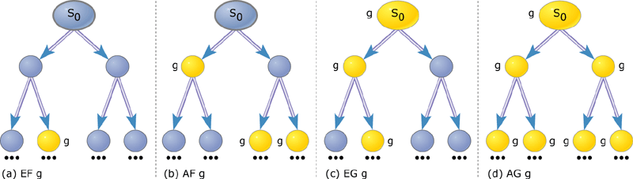
Defining Specifications
Intuition for CTL formulae which are satisfied at state s0

Slide 28
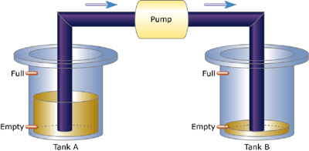
A Simple Two Tank System Example
By Girish Keshav Palshikar, Embedded Systems Programming
http://www.embedded.com/showArticle.jhtml?articleID=17603352

Slide 29
A Simple Two Tank System Example
In symbolic model verifier (SMV) model checking tool, CMU
http://www.cs.cmu.edu/~modelcheck/smv.html
MODULE main
VAR
level_a : {empty, ok, full}; -- lower tank
level_b : {empty, ok, full}; -- upper tank
pump : {on, off};
ASSIGN
next(level_a) := case
level_a = empty : {empty, ok};
level_a = ok & pump = off : {ok, full};
level_a = ok & pump = on : {ok, empty, full};
level_a = full & pump = off : full;
level_a = full & pump = on : {ok, full};
1 : {ok, empty, full};
esac;
next(level_b) := case
level_b = empty & pump = off : empty;
level_b = empty & pump = on : {empty, ok};
level_b = ok & pump = off : {ok, empty};
level_b = ok & pump = on : {ok, empty, full};
level_b = full & pump = off : {ok, full};
level_b = full & pump = on : {ok, full};
1 : {ok, empty, full};
esac;
next(pump) := case
pump = off & (level_a = ok | level_a = full) &
(level_b = empty | level_b = ok) : on;
pump = on & (level_a = empty | level_b = full) : off;
1 : pump; -- keep pump status as it is
esac;
INIT
(pump = off)
SPEC
-- pump if always off if ground tank is empty or up tank is full
-- AG AF (pump = off -> (level_a = empty | level_b = full))
-- it is always possible to reach a state when the up tank is ok or full
AG (EF (level_b = ok | level_b = full))

Slide 30
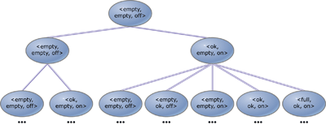
A Simple Two Tank System Example
Initial part of the execution tree for the pump controller system

Slide 31
A Simple Two Tank System Example
Initial part of the execution tree for the pump controller system
-- specification AF pump = on is false
-- as demonstrated by the following execution sequence
-- loop starts here
state 1.1:
level_a = full
level_b = full
pump = off
state 1.2:

Slide 32
A Simple Two Tank System Example
Some other properties
AF (pump = off)
--- for every path beginning at the initial state, there's a state in that path at which the pump is off.
trivially true at the initial state, since in the initial state itself (which is included in all paths) pump = off is true.
AG ((pump = off) -> AF (pump = on))
--- it's always the case that if pump is off then it eventually becomes on.
clearly false in the initial state.
AG AF (pump = off -> (level_a = empty | level_b = full))
---- pump is always off if ground tank is empty or the upper tank is full.
AG (EF (level_b = ok | level_b = full))
--- it's always possible to reach a state when the upper tank is ok or full.

Slide 33

Issues
Temporal logic: (heavy) can be hard to work with
Translations of requirements models to the input language of model checking
engines often times not straightforward.
If no bugs are detected, does this mean that we have achieved verification, or just
got too crude a model or property?
Number of states typically grows exponentially in the number of processes:
cannot be efficiently checked, due to state space explosion
Counter-examples: do not mean anything to the stakeholders; need to be translated
back into the original modeling language.
Deals only with state-oriented behavioral requirements models
(Or, is it more like P, M |= S with Promela?;
Or, is it more like state-oriented behavioral S |= descriptive S?)
G: goals
D: a model of
the environment
R: a model of
the requirements
acts upon
evolution
satisfy
constrains
S: a model of
the sw behavior
 | Fn | NFn
W
R
S
M^{G}, Prog^{G} |= S^{G}; S^{G}, D^{G} |= R^{G}; R^{G}, D^{G} |= G; (G |= ¬P) V (G |~ ¬P)
softgoal satisficing

Slide 34
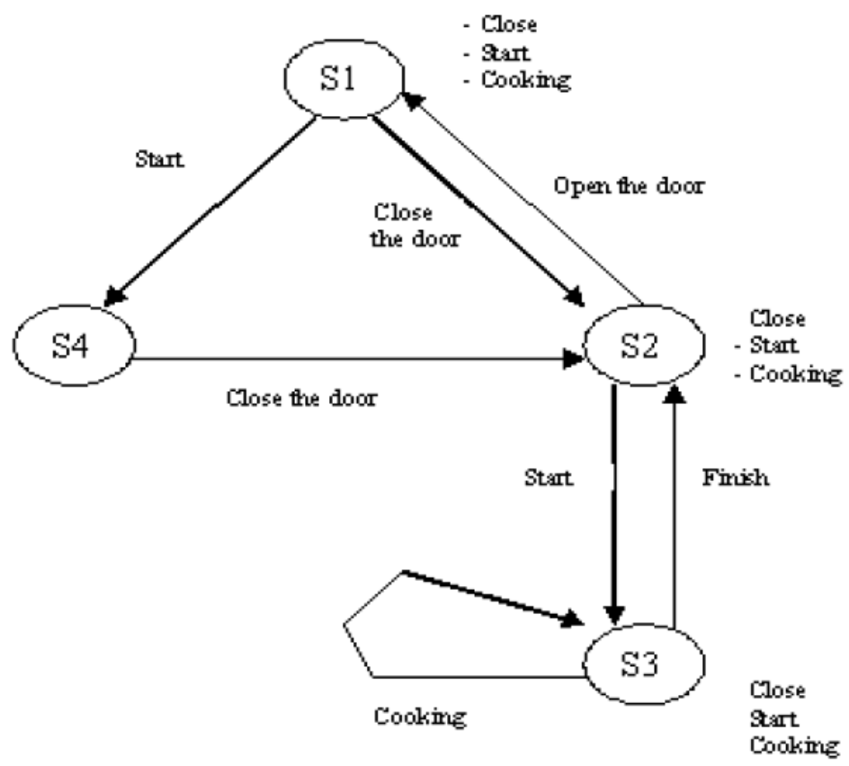
Appendix: Microwave Oven Example
Model
http://pi.informatik.uni-siegen.de/niere/lehre/SS04/SeminarFinal/6_sun/Folien.pdf
M = (S, S0, R, L)
• S = (S1, S2, S3, S4)
• S1 is the initial state
• R = ({S1, S2} {S2, S1}, {S1, S4}, {S4, S2}, {S2, S3}, {S3, S2}, {S3, S3}
• L (S1) = {¬close, ¬ start, ¬ cooking}
L (S2) = {close, ¬ start, ¬ cooking}
L (S3) = {close, start, cooking}
L (S4) = {¬close, start, ¬ cooking}
Specification
AG (start → AF cooking)
2. AG ((close ∧ start) → AF cooking)

Slide 35
Appendix: Microwave Oven Example
M = (S, S0, R, L)
• S = (S1, S2, S3, S4)
• S1 is the initial state
• R = ({S1, S2} {S2, S1}, {S1, S4}, {S4, S2}, {S2, S3}, {S3, S2}, {S3, S3}
• L (S1) = {¬close, ¬ start, ¬ cooking}
L (S2) = {close, ¬ start, ¬ cooking}
L (S3) = {close, start, cooking}
L (S4) = {¬close, start, ¬ cooking}
http://pi.informatik.uni-siegen.de/niere/lehre/SS04/SeminarFinal/6_sun/Folien.pdf
AG (start → AF cooking)
1) Change formal to ¬EF (start ∧ EG ¬ cooking))
2) From simple partial formulas to the more complicated formulas, until all of the formulas are true.
• S (start) = {S3, S4}
• S (¬cooking) = {S1, S2, S4}
• S (EG ¬ cooking) = {S1, S2, S4} (all conditions lie on a path)
• S (start ∧ EG ¬ cooking) = {S4}
• S (EF (start Ù EG ¬ cooking)) = {S1, S2, S3, S4} (can be followed with S4)
• S (¬ (EF (start ∧ EG ¬ cooking))) = {}
2. AG ((close ∧ start) → AF cooking)
1) change formal to ¬ EF(close ∧ start ∧ EG ¬ cooking)
2) Now the algorithm can be applied to the formula
• S (close)= {S2, S3}
• S (start)= {S3, S4}
• S (¬ cooking) = {S1, S2, S4}
• S (EG ¬ cooking) = {S1, S2, S4}
• S (close ∧ start ∧ EG ¬ cooking) = {}
• S (EF (close ∧ start ∧ EG ¬ cooking) = {}
• S (¬ (EF (close ∧ start v EG ¬ cooking)) = {S1, S2, S3, S4}
Model
Checker
M╞ φ

Slide 36
Genealogy
Floyd/Hoare
late 60s
Aristotle 300’s BCE
Kripke 59
Logics of
Programs
Temporal/
Modal Logics
Büchi, 60
Tarski
Pnueli
late 70’s
50’s
ω-automata
S1S
Clarke/Emerson
Early 80’s
Park, 60’s
μ-Calculus
Kurshan
Vardi/Wolper
mid 80’s
CTL Model
Checking
ATV
LTL Model
Checking
Bryant, mid 80’s
QBF
BDD
Symbolic
Model Checking
late 80’s

